Slide 1
FINAL PHYSIC 2

Slide 2
MAIN CONTENTS
04
05
06
The Kinetic Theory of Gases
Entropy and the Second Law of Thermodynamics
Review

Slide 3
CHAPTER 4: The Kinetic Theory of Gases

Slide 4








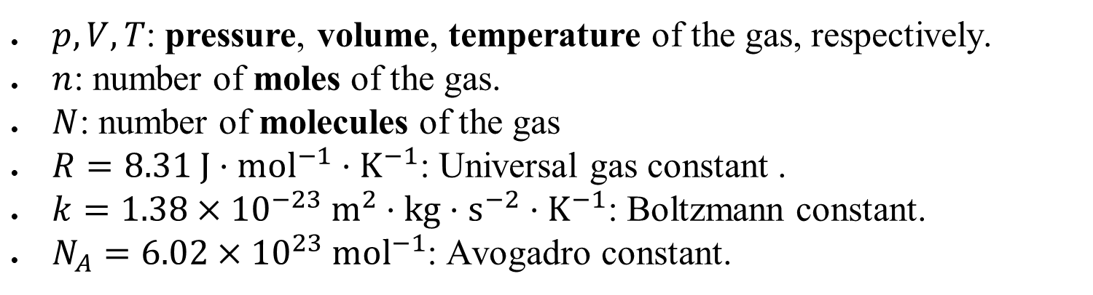

1. Ideal gas
$pV=nRT↔pV=NkT$
$p,V,T$: pressure, volume, temperature of the gas, respectively.
$n$: number of moles of the gas.
$N$: number of molecules of the gas
$R=8.31 J⋅{mol}^{−1}⋅K^{−1}$: Universal gas constant .
$k=1.38×{10}^{−23} m^{2}⋅kg⋅s^{−2}⋅K^{−1}$: Boltzmann constant.
$N_{A}=6.02×{10}^{23} {mol}^{−1}$: Avogadro constant.

Slide 5
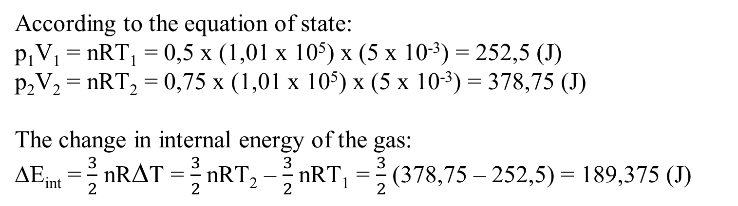
An ideal monatomic gas undergoes an isochoric process, at a constant volume of 5.0 L, from a pressure of 0.50 atm to a final pressure of 0.75 atm. Calculate the change in internal energy of the gas. (1 atm = 1.01 x 10⁵ Pa)
According to the equation of state:
p₁V₁ = nRT₁ = 0,5 x (1,01 x 10⁵) x (5 x 10⁻³) = 252,5 (J)
p₂V₂ = nRT₂ = 0,75 x (1,01 x 10⁵) x (5 x 10⁻³) = 378,75 (J)
The change in internal energy of the gas:
∆E_{int} = $\frac{3}{2}$ nR∆T = $\frac{3}{2}$ nRT₂ – $\frac{3}{2}$ nRT₁ = $\frac{3}{2}$ (378,75 – 252,5) = 189,375 (J)
Notes:
January 2018 (sem1)

Slide 6
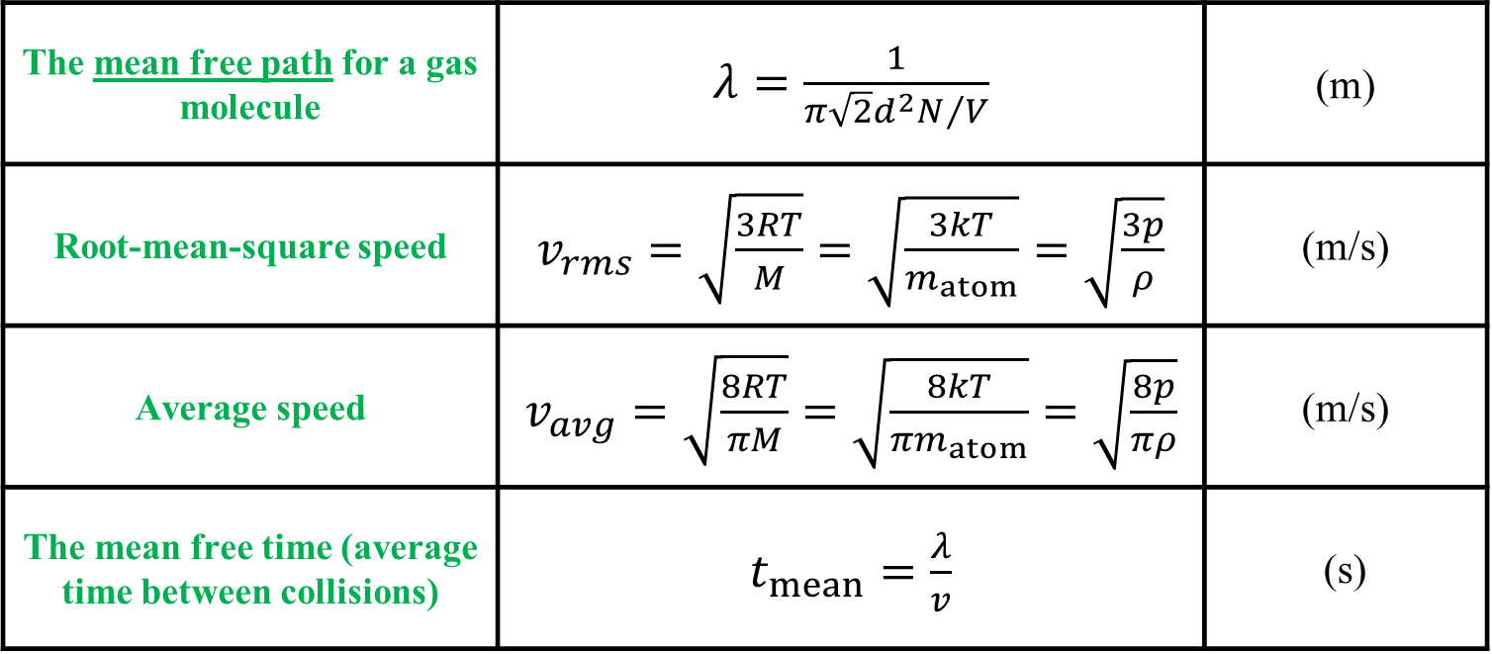



2. Kinetic Theory of Gases
The mean free path for a gas molecule | $λ=\frac{1}{{π\sqrt{2}d^{2}N}/V}$ | (m)
Root-mean-square speed | $v_{rms}=\sqrt{\frac{3RT}{M}}=\sqrt{\frac{3kT}{m_{atom}}}=\sqrt{\frac{3p}{ρ}}$ | (m/s)
Average speed | $v_{avg}=\sqrt{\frac{8RT}{πM}}=\sqrt{\frac{8kT}{πm_{atom}}}=\sqrt{\frac{8p}{πρ}}$ | (m/s)
The mean free time (average time between collisions) | $t_{mean}=\frac{λ}{v}$ | (s)

Slide 7
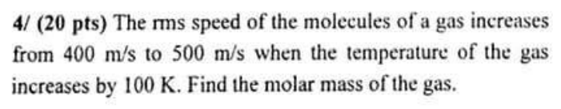

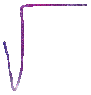
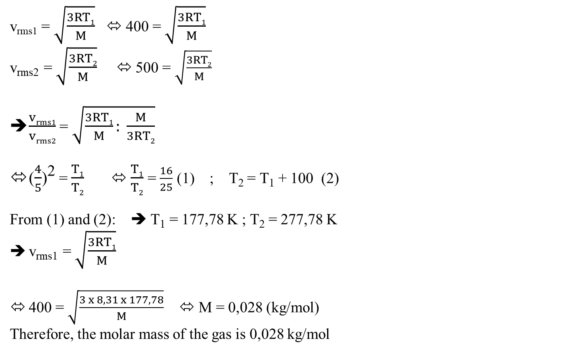
v_{rms1} = $\sqrt{\frac{3RT1}{M}}$ ⬄ 400 = $\sqrt{\frac{3RT1}{M}}$
v_{rms2} = $\sqrt{\frac{3RT2}{M}}$ ⬄ 500 = $\sqrt{\frac{3RT2}{M}}$
$\frac{vrms1}{vrms2}$ = $\sqrt{\frac{3RT1}{M}: \frac{M}{3RT2}}$
($\frac{4}{5}$)² = $\frac{T1}{T2}$ ⬄ $\frac{T1}{T2}$ = $\frac{16}{25}$ (1) ; T₂ = T₁ + 100 (2)
From (1) and (2): ➔ T₁ = 177,78 K ; T₂ = 277,78 K
v_{rms1} = $\sqrt{\frac{3RT1}{M}}$
400 = $\sqrt{\frac{3 x 8,31 x 177,78}{M}}$ ⬄ M = 0,028 (kg/mol)
Therefore, the molar mass of the gas is 0,028 kg/mol

Slide 8
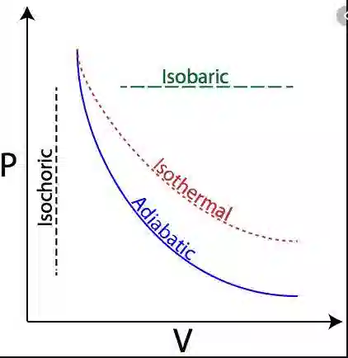
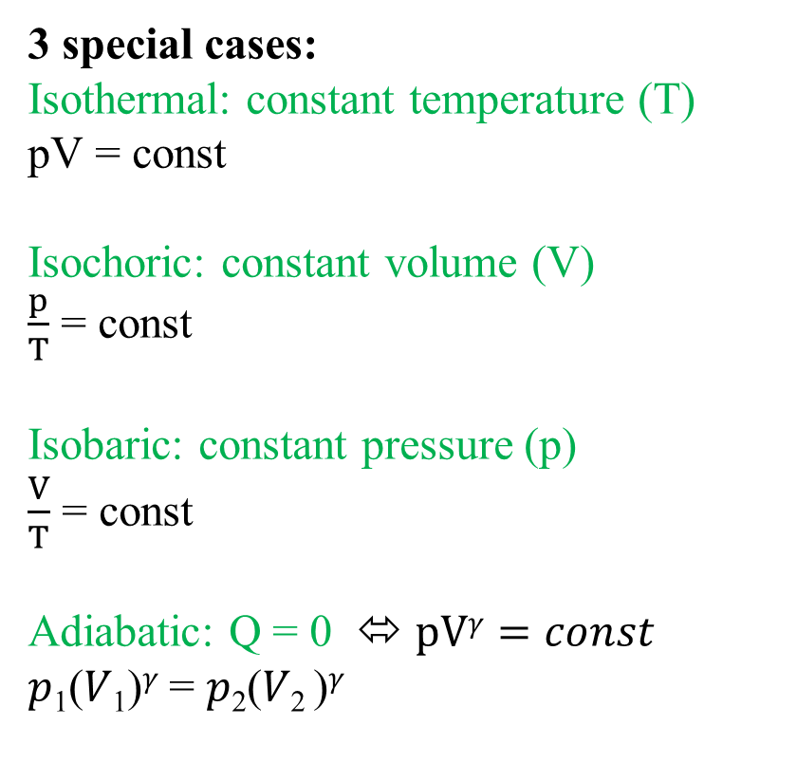
3 special cases:
Isothermal: constant temperature (T)
pV = const
Isochoric: constant volume (V)
$\frac{p}{T}$ = const
Isobaric: constant pressure (p)
$\frac{V}{T}$ = const
Adiabatic: Q = 0 ⬄ pV$γ=const$
𝑝₁(𝑉₁)^{𝛾} = 𝑝₂(𝑉₂ )^{𝛾}

Slide 9
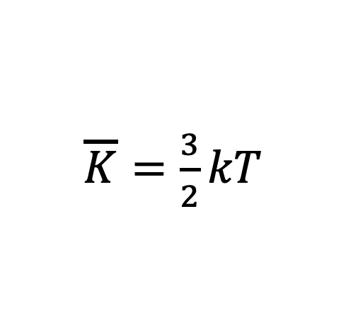
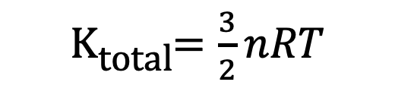
Translational Kinetic Energy per Molecule
Total Translational Kinetic Energy (n moles)
$\overline{K}=\frac{3}{2}kT$
K_{total}$=\frac{3}{2}nRT$

Slide 10


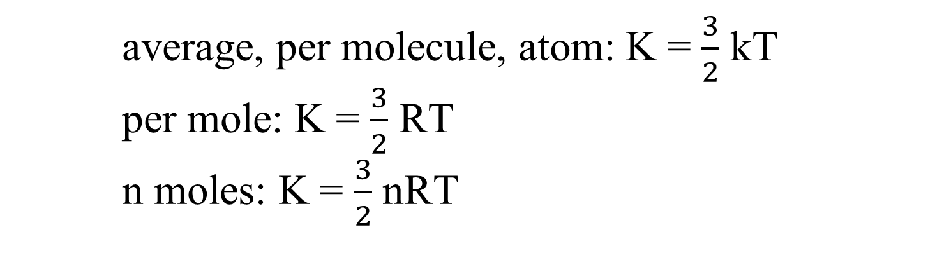





average, per molecule, atom: K = $\frac{3}{2}$ kT
per mole: K = $\frac{3}{2}$ RT
n moles: K = $\frac{3}{2}$ nRT

Slide 11
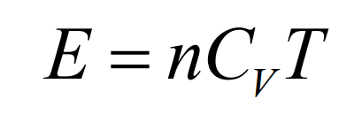
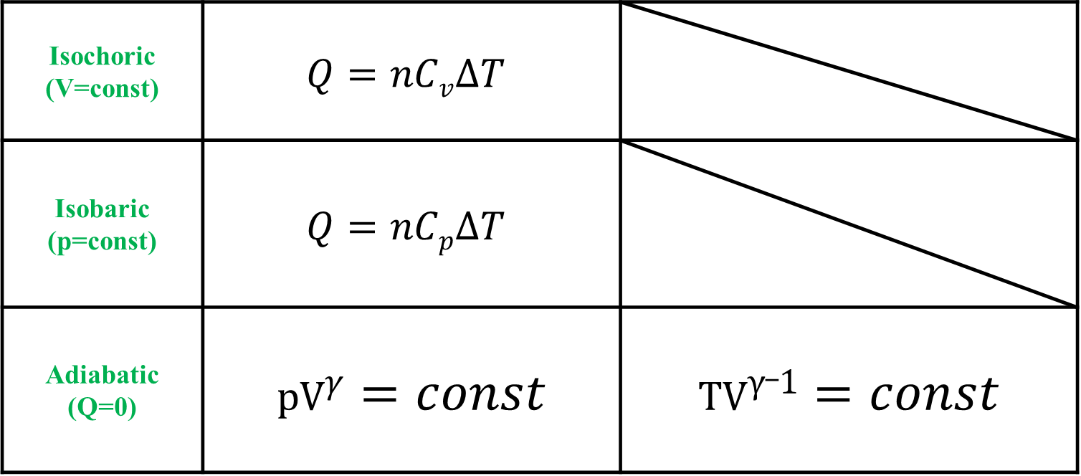
3. Molar specific heats of an ideal gas
Isochoric (V=const) | $$Q=nCv∆T$$
Isobaric (p=const) | $$Q=nCp∆T$$
Adiabatic (Q=0) | pV$γ=const$ | TV$γ_1=const$

Slide 12
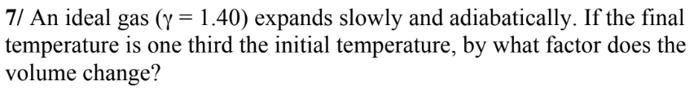
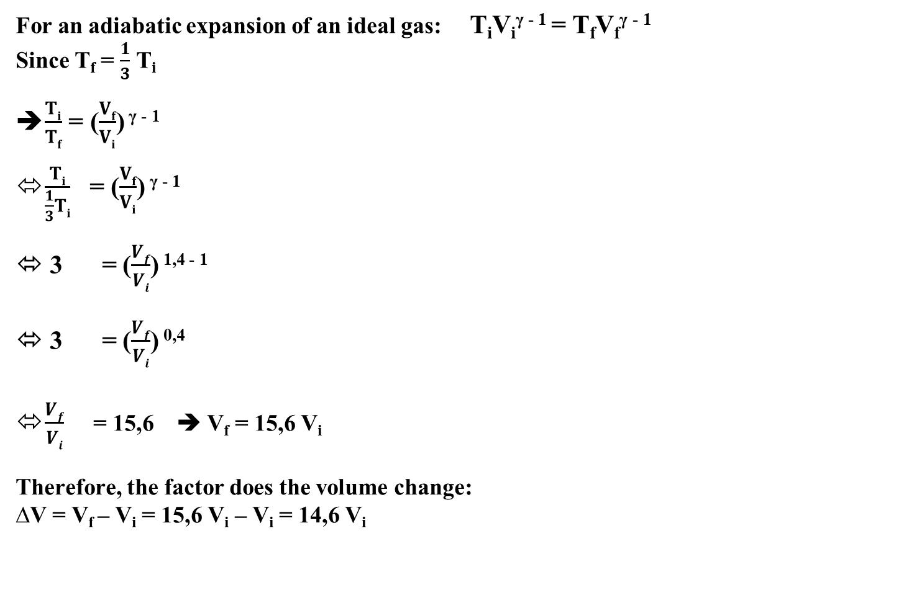
For an adiabatic expansion of an ideal gas: T_{i}V_{i}^{γ - 1} = T_{f}V_{f}^{γ - 1}
Since T_{f} = $\frac{1}{3}$ T_{i}
$\frac{Ti}{Tf}$ = ($\frac{Vf}{Vi}$) ^{γ - 1}
$\frac{Ti}{\frac{1}{3}Ti}$ = ($\frac{Vf}{Vi}$) ^{γ - 1}
⬄ 3 = ($\frac{Vf}{Vi}$) ^{1,4 - 1}
⬄ 3 = ($\frac{Vf}{Vi}$) ^{0,4}
$\frac{Vf}{Vi}$ = 15,6 ➔ V_{f} = 15,6 V_{i}
Therefore, the factor does the volume change:
∆V = V_{f} – V_{i} = 15,6 V_{i} – V_{i} = 14,6 V_{i}

Slide 13
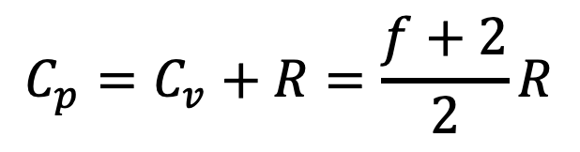
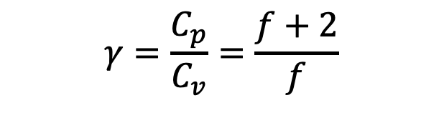
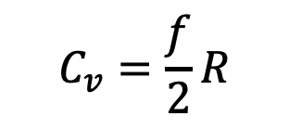
3. Molar specific heats of an ideal gas
Classifying the ideal gases into three types:
Monatomic: f=3.
Diatomic: f=5.
Polyatomic: f=6.
$$C_{v}=\frac{f}{2}R$$
$$C_{p}=C_{v}+R=\frac{f+2}{2}R$$
$$γ=\frac{C_{p}}{C_{v}}=\frac{f+2}{f}$$

Slide 14
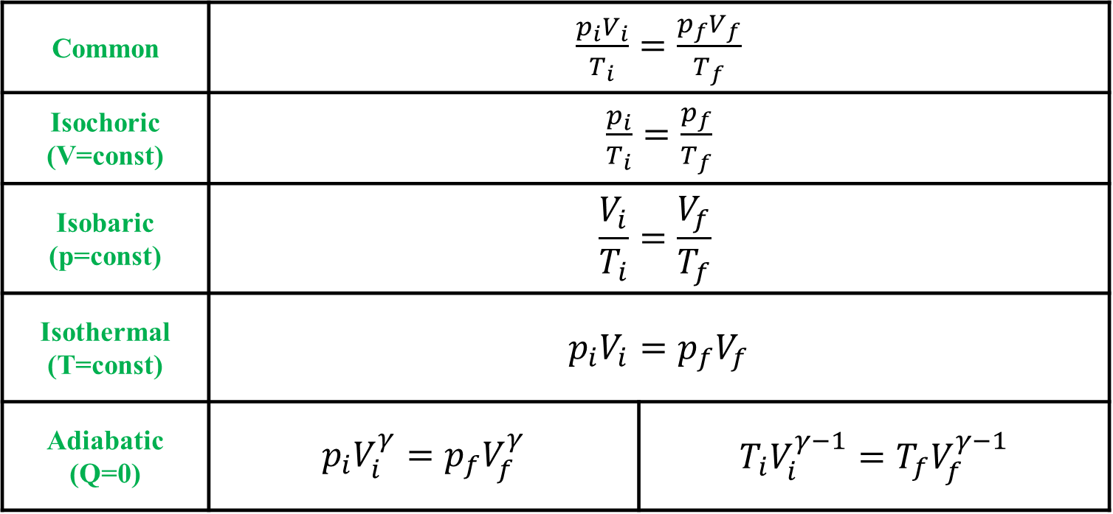
4. Sate Conversing of an Ideal Gas
Common | $\frac{p_{i}V_{i}}{T_{i}}=\frac{p_{f}V_{f}}{T_{f}}$
Isochoric (V=const) | $\frac{p_{i}}{T_{i}}=\frac{p_{f}}{T_{f}}$
Isobaric (p=const) | $$\frac{V_{i}}{T_{i}}=\frac{V_{f}}{T_{f}}$$
Isothermal (T=const) | $p_{i}V_{i}=p_{f}V_{f}$ | TV$γ=const$
Adiabatic (Q=0) | $p_{i}V_{i}^{γ}=p_{f}V_{f}^{γ}$ | $T_{i}V_{i}^{γ−1}=T_{f}V_{f}^{γ−1}$

Slide 15
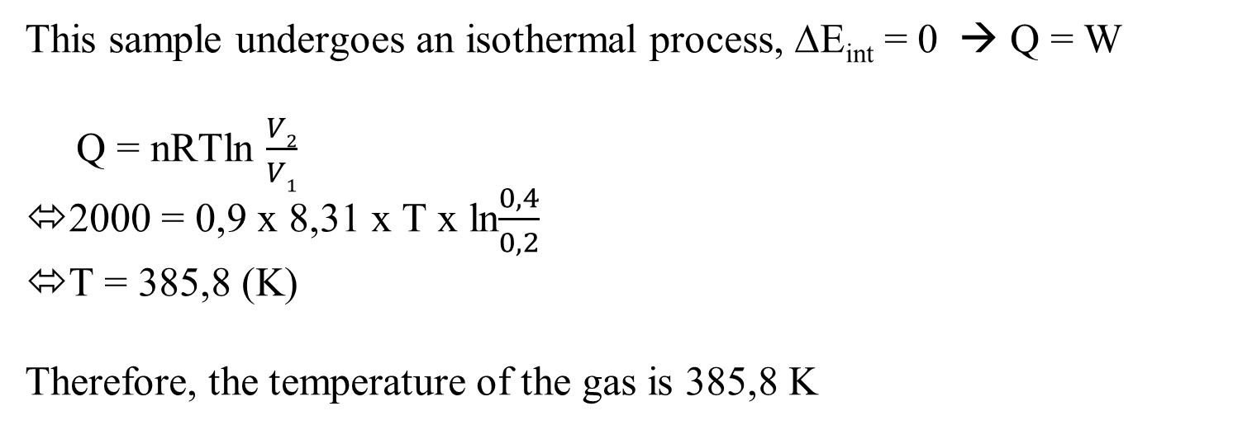
A 0.9 mol sample of an ideal gas undergoes an isothermal process. The initial volume is 0.20 m³ and the final volume is 0.40 m³ . If the heat added to the gas is 2000 J, find the temperature of the gas.
This sample undergoes an isothermal process, ∆E_{int} = 0 → Q = W
Q = nRTln $\frac{V2}{V1}$
2000 = 0,9 x 8,31 x T x ln$\frac{0,4}{0,2}$
T = 385,8 (K)
Therefore, the temperature of the gas is 385,8 K

Slide 16

Chapter 5: Entropy and the Second Law of Thermodynamics

Slide 17
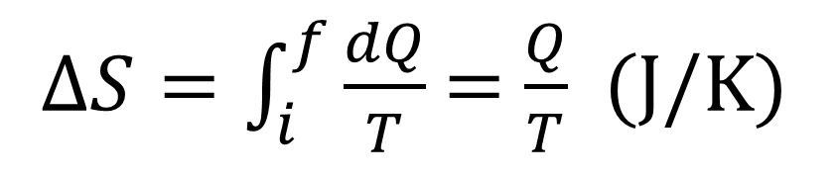

1. Change In Entropy
$∆S=\int_{i}^{f}{\frac{dQ}{T}}$ = $\frac{Q}{T}$ (J/K)

Slide 18



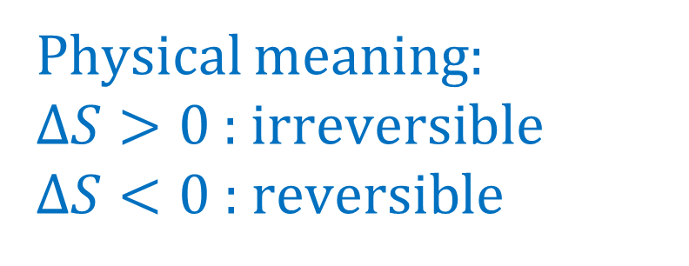
2. Second Law of Thermodynamics
$$∆S>0$$
Physical meaning:
$∆S>0$: irreversible
$∆S<0$ : reversible

Slide 19
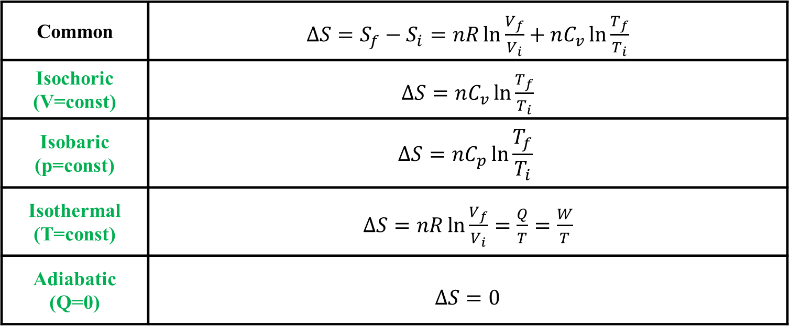

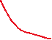
3. Entropy in Ideal gas
Unit: J/K
Common | $∆S=S_{f}−S_{i}=nR\ln{\frac{V_{f}}{V_{i}}}+nC_{v}\ln{\frac{T_{f}}{T_{i}}}$
Isochoric (V=const) | $∆S=nC_{v}\ln{\frac{T_{f}}{T_{i}}}$
Isobaric (p=const) | $$∆S=nC_{p}\ln{\frac{T_{f}}{T_{i}}}$$
Isothermal (T=const) | $∆S=nR\ln{\frac{V_{f}}{V_{i}}}=\frac{Q}{T}=\frac{W}{T}$
Adiabatic (Q=0) | $∆S=0$

Slide 20
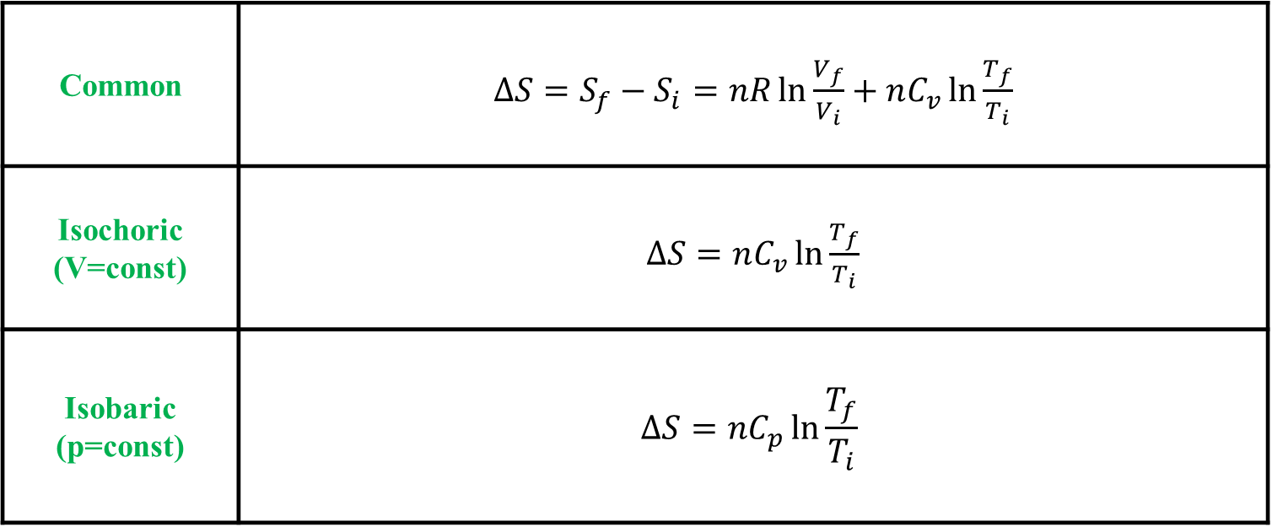
4. Entropy in Liquid and Solid
Unit: J/K
Common | $∆S=S_{f}−S_{i}=nR\ln{\frac{V_{f}}{V_{i}}}+nC_{v}\ln{\frac{T_{f}}{T_{i}}}$
Isochoric (V=const) | $∆S=nC_{v}\ln{\frac{T_{f}}{T_{i}}}$
Isobaric (p=const) | $$∆S=nC_{p}\ln{\frac{T_{f}}{T_{i}}}$$

Slide 21




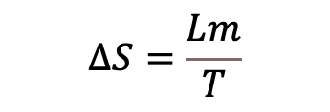
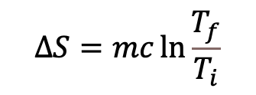
Cooling or heating
$$∆S=mc\ln{\frac{T_{f}}{T_{i}}}$$
$$∆S=\frac{Lm}{T}$$
$$∆S=\frac{Q}{T}$$
Phase change
T=const

Slide 22
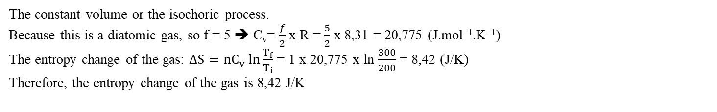
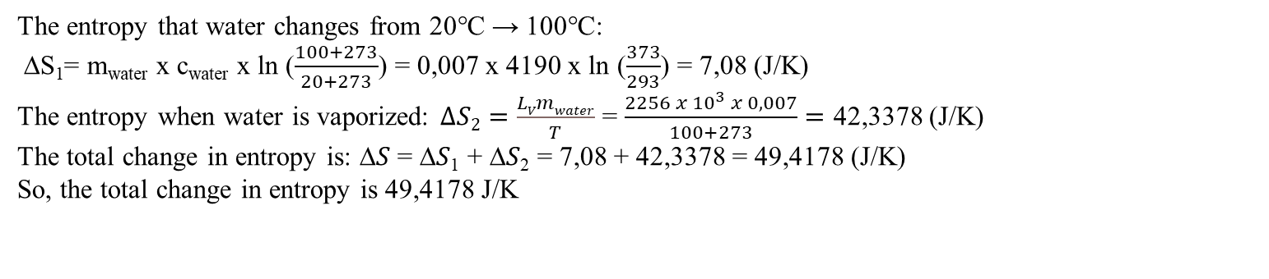
The temperature of 1.0 mole of a diatomic ideal gas is raised reversibly from 200 K to 300 K at constant volume . Find the entropy change of the gas.
The constant volume or the isochoric process.
Because this is a diatomic gas, so f = 5 ➔ C_{v}= $\frac{f}{2}$x R = $\frac{5}{2}$ x 8,31 = 20,775 (J.mol⁻¹.K⁻¹)
The entropy change of the gas: $∆S=nC_{v}\ln{\frac{T_{f}}{T_{i}}}$ = 1 x 20,775 x ln $\frac{300}{200}$ = 8,42 (J/K)
Therefore, the entropy change of the gas is 8,42 J/K
Three moles of an ideal gas undergo a free expansion from an initial volume of 6 L to 10 L. Find the change in entropy of the gas.
For free expansion, it can be considered as an isothermal process: ∆S = $nR\ln{\frac{V_{f}}{V_{i}}}$ = 3 x 8,31 x ln $\frac{10}{6}$ = 12,734 (J/K)
Therefore the change in entropy of the gas is 12,734 (J/K)
Calculate the change in entropy when 7g of water at 20℃ is raised to 100℃ and then converted to steam at that temperature (𝐿_{𝑉} = 2256kJ/kg, 𝑐_{𝑤𝑎𝑡𝑒𝑟} =4190 J/kg.K)
The entropy that water changes from 20℃ → 100℃:
∆S₁= m_{water} x c_{water} x ln ($\frac{100+273}{20+273}$) = 0,007 x 4190 x ln ($\frac{373}{293}$) = 7,08 (J/K)
The entropy when water is vaporized: $∆S2=\frac{LVmwater}{T}$ = $\frac{2256 x {10}^{3} x 0,007}{100+273}=$ 42,3378 (J/K)
The total change in entropy is: ∆𝑆 = ∆𝑆₁ + ∆𝑆₂ = 7,08 + 42,3378 = 49,4178 (J/K)
So, the total change in entropy is 49,4178 J/K
Notes:
January 2019

Slide 23
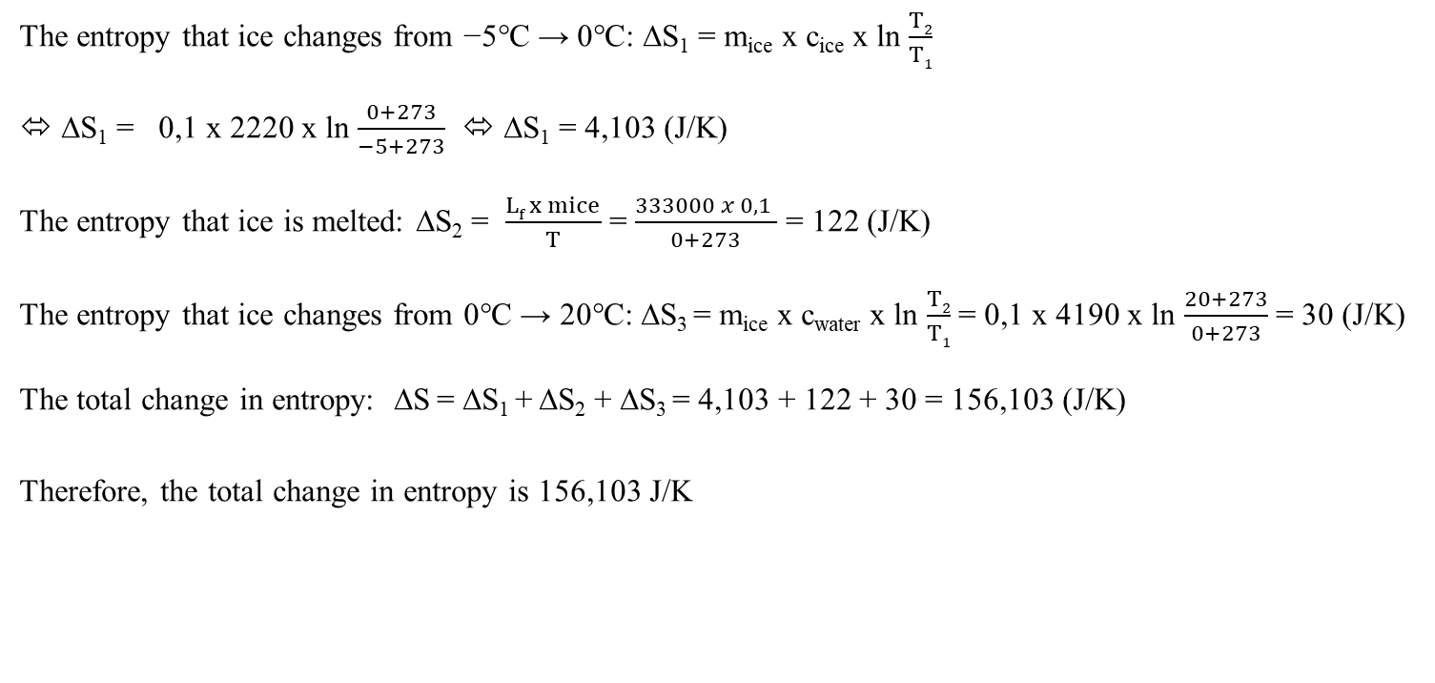
The entropy that ice changes from −5℃ → 0℃: ∆S₁ = m_{ice} x c_{ice} x ln $\frac{T2}{T1}$
⬄ ∆S₁ = 0,1 x 2220 x ln $\frac{0+273}{−5+273}$ ⬄ ∆S₁ = 4,103 (J/K)
The entropy that ice is melted: ∆S₂ = $\frac{Lf x mice}{T}$ = $\frac{333000 x 0,1 }{0+273}$ = 122 (J/K)
The entropy that ice changes from 0℃ → 20℃: ∆S₃ = m_{ice} x c_{water} x ln $\frac{T2}{T1}$ = 0,1 x 4190 x ln $\frac{20+273}{0+273}$ = 30 (J/K)
The total change in entropy: ∆S = ∆S₁ + ∆S₂ + ∆S₃ = 4,103 + 122 + 30 = 156,103 (J/K)
Therefore, the total change in entropy is 156,103 J/K
Notes:
June 2019 (sem2)

Slide 24
REVIEW

Slide 25
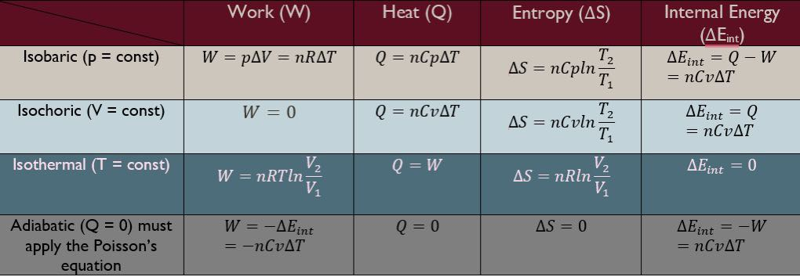





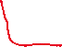



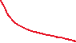


Slide 26
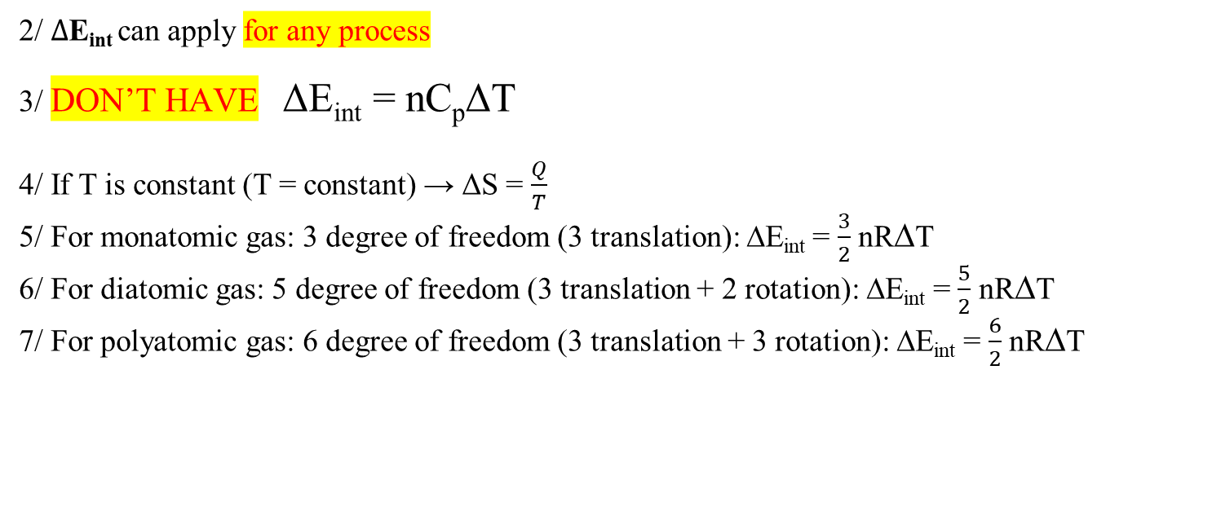
1/ Translational kinetic energy is ONLY FOR monatomic: K = E_{trans} = $\frac{3}{2}$ nRT (J)
NOTES
2/ $∆$E_{int} can apply for any process
3/ DON’T HAVE ΔE_{int} = nC_{p}ΔT
4/ If T is constant (T = constant) → ΔS = $\frac{Q}{T}$
5/ For monatomic gas: 3 degree of freedom (3 translation): ∆E_{int} = $\frac{3}{2}$ nR∆T
6/ For diatomic gas: 5 degree of freedom (3 translation + 2 rotation): ∆E_{int} = $\frac{5}{2}$ nR∆T
7/ For polyatomic gas: 6 degree of freedom (3 translation + 3 rotation): ∆E_{int} = $\frac{6}{2}$ nR∆T

Slide 27

















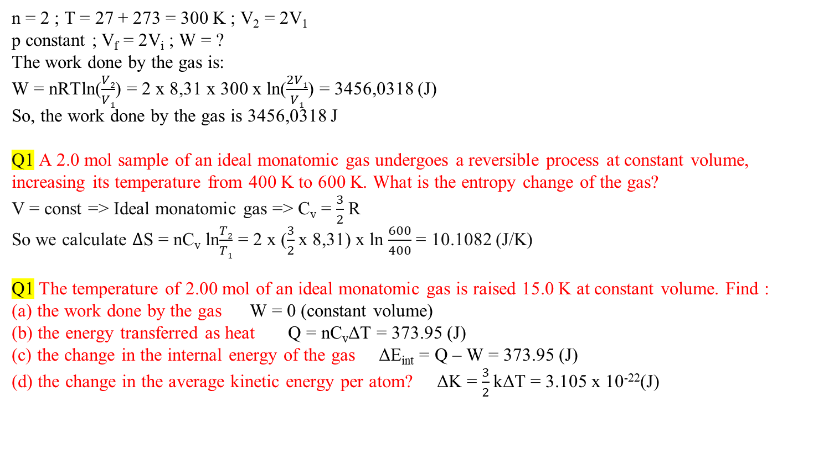



n = 2 ; T = 27 + 273 = 300 K ; V₂ = 2V₁
p constant ; V_{f} = 2V_{i} ; W = ?
The work done by the gas is:
W = nRTln($\frac{V2}{V1}$) = 2 x 8,31 x 300 x ln($\frac{2V1}{V1}$) = 3456,0318 (J)
So, the work done by the gas is 3456,0318 J
Q1 A 2.0 mol sample of an ideal monatomic gas undergoes a reversible process at constant volume, increasing its temperature from 400 K to 600 K. What is the entropy change of the gas?
V = const => Ideal monatomic gas => C_{v} = $\frac{3}{2}$ R
So we calculate $∆$S = nC_{v} ln$\frac{T2}{T1}$ = 2 x ($\frac{3}{2}$x 8,31) x ln $\frac{600}{400}$ = 10.1082 (J/K)
Q1 The temperature of 2.00 mol of an ideal monatomic gas is raised 15.0 K at constant volume. Find :
(a) the work done by the gas W = 0 (constant volume)
(b) the energy transferred as heat Q = nC_{v}ΔT = 373.95 (J)
(c) the change in the internal energy of the gas ΔE_{int} = Q – W = 373.95 (J)
(d) the change in the average kinetic energy per atom? ΔK = $\frac{3}{2}$kΔT = 3.105 x 10⁻²²(J)

Slide 28
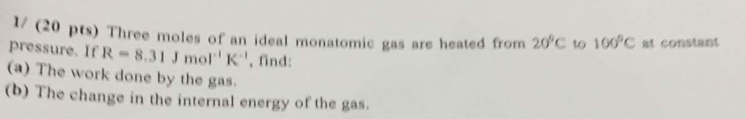













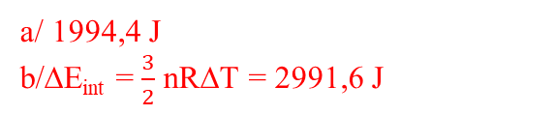





According to the equation of state:
p₁V₁ = nRT₁ = 2 x 8,31 x (50+273) = 5368,26
p₁V₂ = nRT₂ = 2 x 8,31 x (150+273) = 7030,26
The work done by the gas:
W = p∆V = p₁ (V₂ – V₁) = p₁V₂ – p₁V₁ = 7030,26 – 5368,26 = 1662 (J)
Therefore, the work done by the gas is 1662 J
a/ 1994,4 J
b/∆E_{int} = $\frac{3}{2}$ nR∆T = 2991,6 J
The relationship between pressure, volume and rms speed: p = $\frac{nMv^{2}rms}{3V}$ = $\frac{10 x 0,1 x {300}^{2}}{3 x 0,3 }$ = 100000 (Pa)
So, the pressure of the gas is 100000 Pa

Slide 29



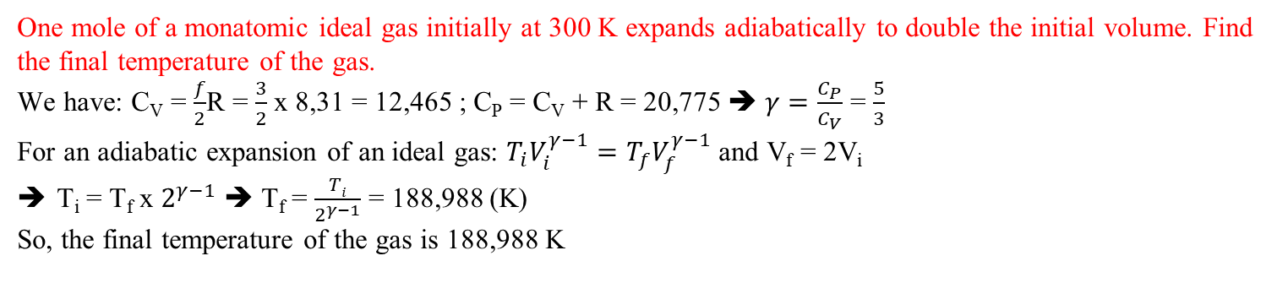





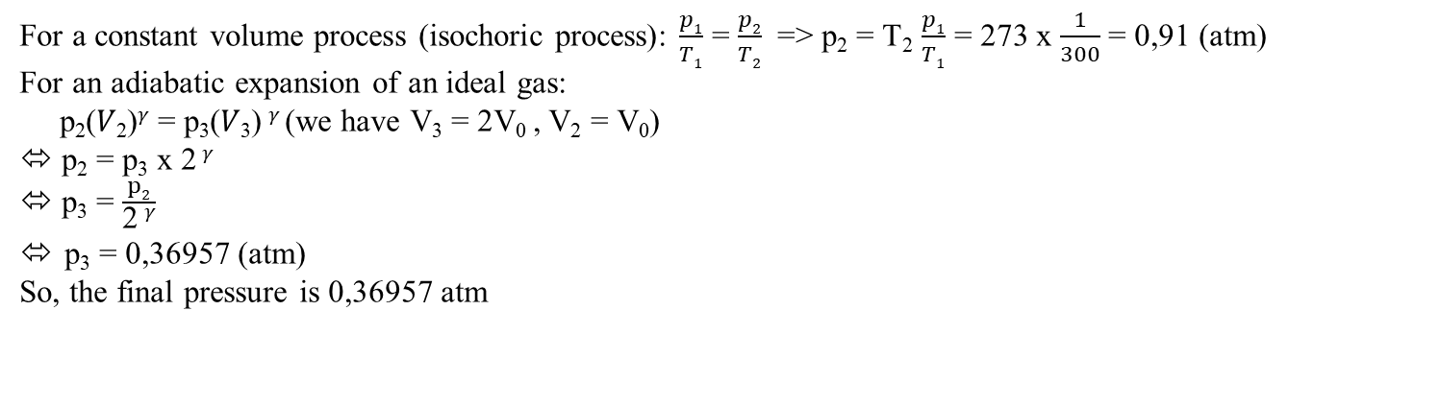
An ideal gas (𝛾 = 1.3) is initially at 𝑇₁ = 300𝐾 and 𝑝₁ = 1.0 𝑎𝑡𝑚. The gas is cooled at constant volume to 𝑇₂ = 273𝐾. It then expands adiabatically to twice its original volume. What is its final pressure?
For a constant volume process (isochoric process): $\frac{p1}{T1}$ = $\frac{p2}{T2}$ => p₂ = T₂ $\frac{p1}{T1}$ = 273 x $\frac{1}{300}$ = 0,91 (atm)
For an adiabatic expansion of an ideal gas:
p₂(𝑉₂)^{𝛾} = p₃(𝑉₃) ^{𝛾} (we have V₃ = 2V₀ , V₂ = V₀)
⬄ p₂ = p₃ x 2 ^{𝛾}
⬄ p₃ = $\frac{p2}{\text{2} \text{γ}}$
p₃ = 0,36957 (atm)
So, the final pressure is 0,36957 atm
One mole of a monatomic ideal gas initially at 300 K expands adiabatically to double the initial volume. Find the final temperature of the gas.
We have: C_{V} = $\frac{f}{2}$R = $\frac{3}{2}$ x 8,31 = 12,465 ; C_{P} = C_{V} + R = 20,775 ➔ $γ=\frac{C_{P}}{C_{V}}$ = $\frac{5}{3}$
For an adiabatic expansion of an ideal gas: $T_{i}V_{i}^{γ−1}=T_{f}V_{f}^{γ−1}$ and V_{f} = 2V_{i}
T_{i} = T_{f} x $2^{γ−1}$ ➔ T_{f} = $\frac{Ti}{2^{γ−1}}$ = 188,988 (K)
So, the final temperature of the gas is 188,988 K

Slide 30
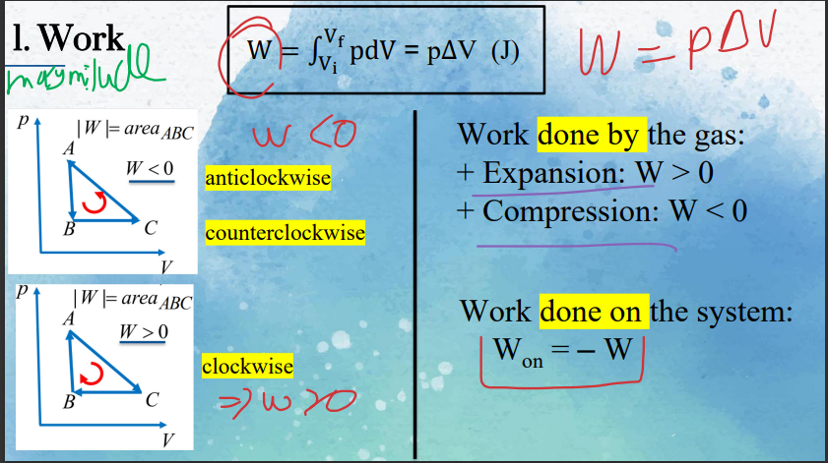



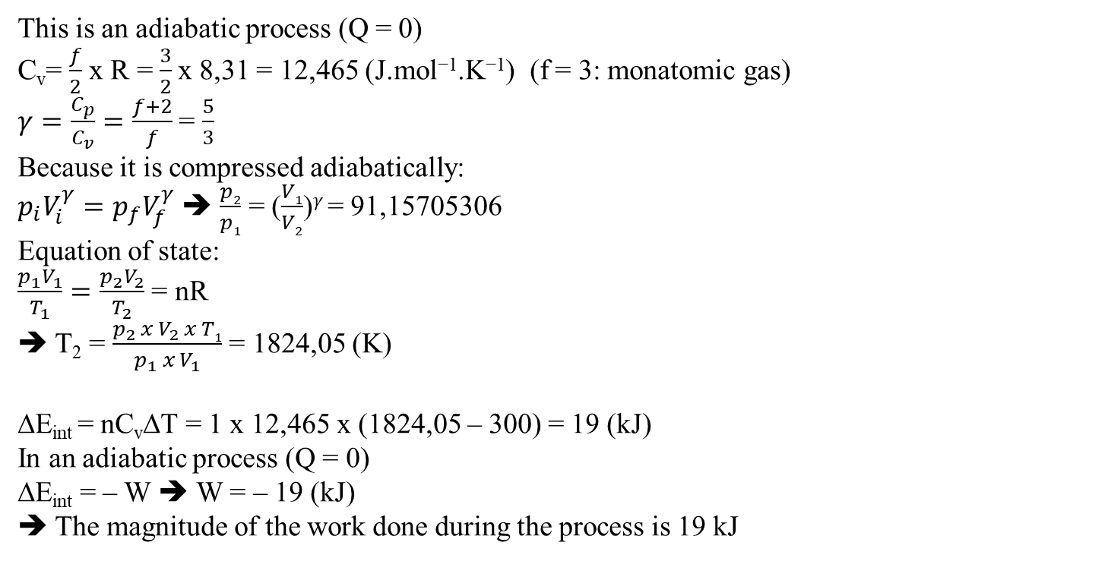












One mole of an ideal monatomic gas is initially at a temperature of 300 K, and has a volume of 1.0 L. It is compressed adiabatically to a volume of 0.0667 L. Calculate the magnitude of the work done during the process
This is an adiabatic process (Q = 0)
C_{v}= $\frac{f}{2}$ x R = $\frac{3}{2}$x 8,31 = 12,465 (J.mol⁻¹.K⁻¹) (f = 3: monatomic gas)
$γ=\frac{C_{p}}{C_{v}}=\frac{f+2}{f}$ = $\frac{5}{3}$
Because it is compressed adiabatically:
$p_{i}V_{i}^{γ}=p_{f}V_{f}^{γ}$ ➔ $\frac{p2}{p1}$ = ($\frac{V1}{V2}$)$γ$ = 91,15705306
Equation of state:
$\frac{p_{1}V_{1}}{T_{1}}=\frac{p_{2}V_{2}}{T_{2}}$ = nR
➔ T₂ = $\frac{p_{2} x{ V}_{2} x T1}{p_{1}{ x V}_{1}}$ = 1824,05 (K)
∆E_{int} = nC_{v}∆T = 1 x 12,465 x (1824,05 – 300) = 19 (kJ)
In an adiabatic process (Q = 0)
∆E_{int} = – W ➔ W = – 19 (kJ)
➔ The magnitude of the work done during the process is 19 kJ

Slide 31
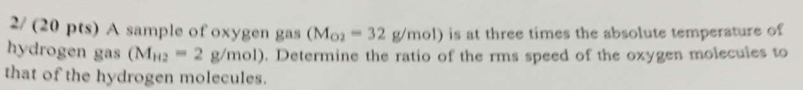


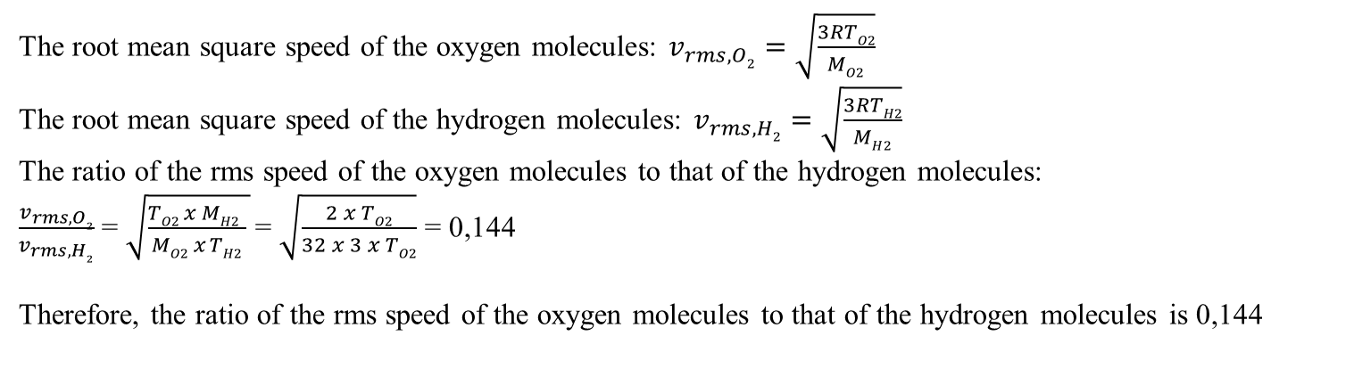









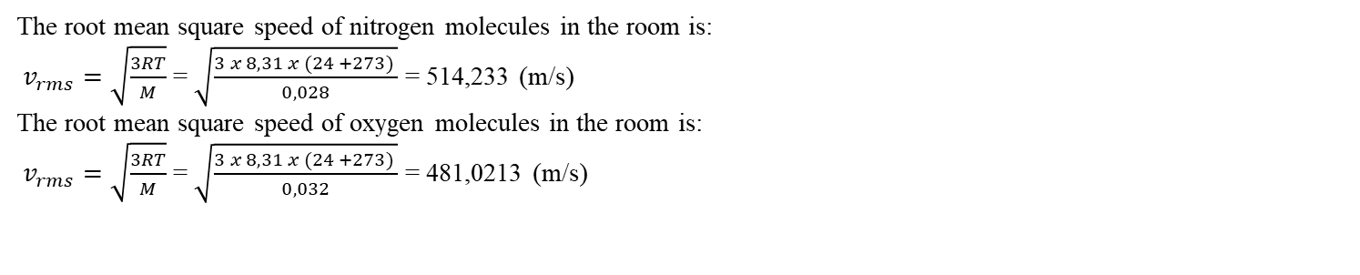



The root mean square speed of nitrogen molecules in the room is:
$v_{rms}=\sqrt{\frac{3RT}{M}}$ = $\sqrt{\frac{3 x 8,31 x (24 +273) }{0,028}}$ = 514,233 (m/s)
The root mean square speed of oxygen molecules in the room is:
$v_{rms}=\sqrt{\frac{3RT}{M}}$ = $\sqrt{\frac{3 x 8,31 x (24 +273) }{0,032}}$ = 481,0213 (m/s)
The root mean square speed of the oxygen molecules: $v_{rms, O2}=\sqrt{\frac{3RTO2}{MO2}}$
The root mean square speed of the hydrogen molecules: $v_{rms, H2}=\sqrt{\frac{3RTH2}{MH2}}$
The ratio of the rms speed of the oxygen molecules to that of the hydrogen molecules:
$\frac{v_{rms, O2}}{v_{rms, H2}}$ = $\sqrt{\frac{TO2 x MH2 }{MO2 x TH2} }$= $\sqrt{\frac{2 x TO2}{32 x 3 x TO2}}$ = 0,144
Therefore, the ratio of the rms speed of the oxygen molecules to that of the hydrogen molecules is 0,144

Slide 32
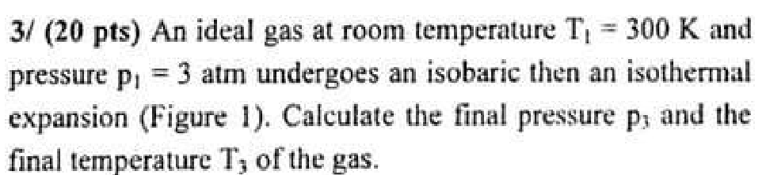
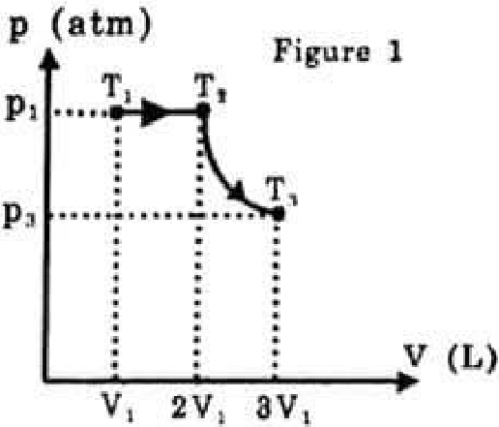
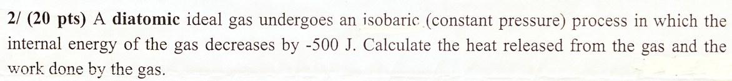
















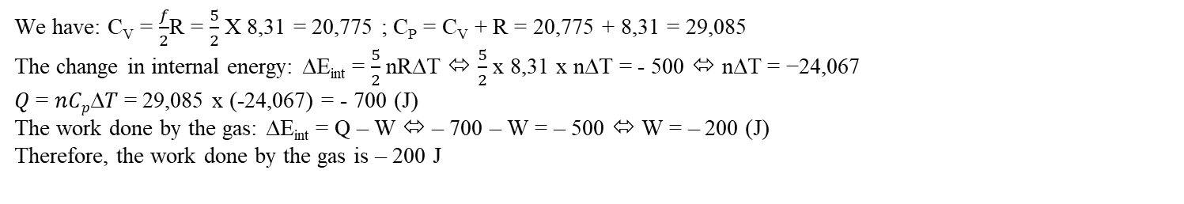


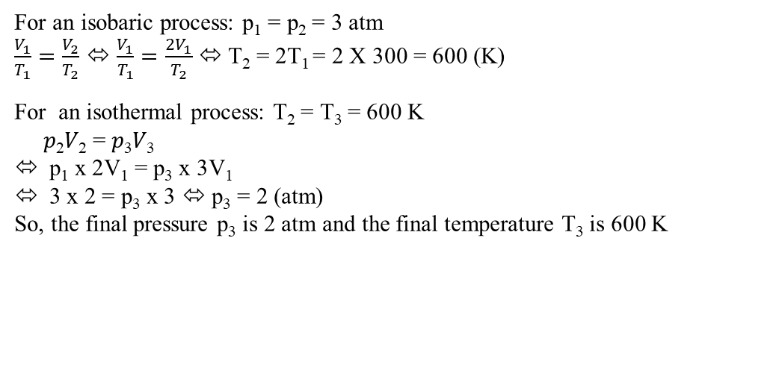

For an isobaric process: p₁ = p₂ = 3 atm
$\frac{V_{1}}{T_{1}}=\frac{V_{2}}{T_{2}}$ ⬄ $\frac{V_{1}}{T_{1}}=\frac{2V_{1}}{T_{2}}$ ⬄ T₂ = 2T₁ = 2 X 300 = 600 (K)
For an isothermal process: T₂ = T₃ = 600 K
𝑝₂𝑉₂ = 𝑝₃𝑉₃
p₁ x 2V₁ = p₃ x 3V₁
3 x 2 = p₃ x 3 ⬄ p₃ = 2 (atm)
So, the final pressure p₃ is 2 atm and the final temperature T₃ is 600 K
We have: C_{V} = $\frac{f}{2}$R = $\frac{5}{2}$ X 8,31 = 20,775 ; C_{P} = C_{V} + R = 20,775 + 8,31 = 29,085
The change in internal energy: ∆E_{int} = $\frac{5}{2}$ nR∆T ⬄ $\frac{5}{2}$ x 8,31 x n∆T = - 500 ⬄ n∆T = −24,067
𝑄 = 𝑛𝐶_{𝑝}∆𝑇 = 29,085 x (-24,067) = - 700 (J)
The work done by the gas: ∆E_{int} = Q – W ⬄ – 700 – W = – 500 ⬄ W = – 200 (J)
Therefore, the work done by the gas is – 200 J

Slide 33

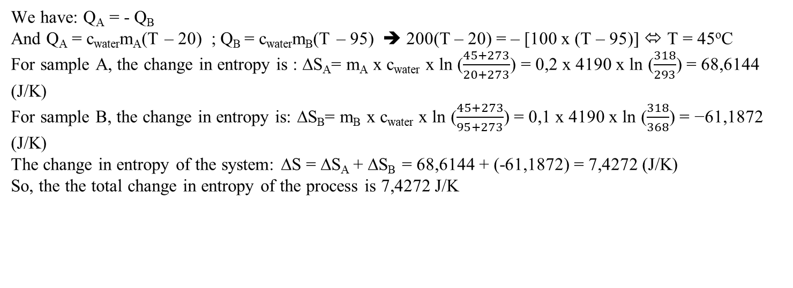


You mix two sample of water. Sample A is 200 g at 20℃. Sample B is 100 g at 95℃. Calculate the total change in entropy of the process, which is the sum of the change in entropy of both samples (the specific heat of water c = 4190 J/kg.K)
We have: Q_{A} = - Q_{B}
And Q_{A} = c_{water}m_{A}(T – 20) ; Q_{B} = c_{water}m_{B}(T – 95) ➔ 200(T – 20) = – [100 x (T – 95)] ⬄ T = 45ºC
For sample A, the change in entropy is : ∆S_{A}= m_{A} x c_{water} x ln ($\frac{45+273}{20+273}$) = 0,2 x 4190 x ln ($\frac{318}{293}$) = 68,6144 (J/K)
For sample B, the change in entropy is: ∆S_{B}= m_{B} x c_{water} x ln ($\frac{45+273}{95+273}$) = 0,1 x 4190 x ln ($\frac{318}{368}$) = −61,1872 (J/K)
The change in entropy of the system: ∆S = ∆S_{A} + ∆S_{B} = 68,6144 + (-61,1872) = 7,4272 (J/K)
So, the the total change in entropy of the process is 7,4272 J/K

Slide 34


We have: Q_{Fe} = − Q_{Al}
And Q_{Al} = m_{Al} x c_{Al} x ∆T = 0,1 x 0,91 x 1000 x (200 – 600) = – 36400 (J) ➔ Q_{Fe} = 36400 (J)
a/ The change in entropy of the iron block: ∆S_{Fe} = $\frac{QFe}{T}$ = $\frac{36400}{200 }$ = 182 (J/K)
b/ The change in entropy of the block of aluminum: ∆S_{Al} = m_{Al} x c_{Al} x ln $\frac{200}{600}$ = 0,1 x 0,91 x 1000 x ln $\frac{200}{600}$ = – 99,97 (J/K)
The change in entropy of the system: ∆S_{system} = ∆S_{Fe} + ∆S_{Al} = 182 + (–99,97) = 82,03 (J/K)
The physical meaning of the result:
Because ∆S_{system} ≥ 0 ➔ The process is irreversible
Notes:
January 2018 (sem1)

Slide 35


a) We have: Q_{ice} = − Q_{water}
𝑄_{𝑖𝑐𝑒} = 𝑐_{𝑖𝑐𝑒}𝑚_{𝑖𝑐𝑒}(0 − −5) + 𝐿_{𝑓}𝑚_{𝑖𝑐𝑒} + 𝑐_{𝑤𝑎𝑡𝑒𝑟}𝑚_{𝑖𝑐𝑒} (𝑇 − 0) ; Q_{water} = c_{water}m_{water}(T – 100)
𝑐_{𝑖𝑐𝑒}𝑚_{𝑖𝑐𝑒}(0 − −5) + 𝐿_{𝑓}𝑚_{𝑖𝑐𝑒} + 𝑐_{𝑤𝑎𝑡𝑒𝑟}𝑚_{𝑖𝑐𝑒} (𝑇 − 0) = - [c_{water}m_{water}(T – 100)]
2220 x 0,1 x 5 + 333000 x 0,1 + 4190 x 0,1 x T = - [4190 x 0,3 x (T – 100)] ➔ T = 54,4689ºC
For 100-g block of ice, we have:
The entropy that ice changes from −5℃ → 0℃: ∆S_{1,ice} = m_{ice} x c_{ice} x ln $\frac{0+273}{−5+273}$ = 4,1036 (J/K)
The entropy that ice is melted: $∆S2,ice=\frac{Lf,icemice}{Tice}$ = $\frac{333000 x 0,1}{0+273}$ = 121,978 (J/K)
The entropy that ice changes from 0℃ → 54.4689℃: ∆S_{3,ice} = m_{ice} x c_{water} x ln $\frac{54,4689+273}{0+273}$ = 76,225 (J/K)
The total change in entropy of ice: ∆S_{ice} = ∆S_{1,ice} + ∆S_{2,ice} + ∆S_{3,ice} = 4,1036 + 121,978 + 76,225 = 202,3066 (J/K)
For 300-g of liquid water, we have: ∆S_{water} = m_{water} x c_{water} x ln $\frac{54,4689+273}{100+273}$ = -163,6429 (J/K)
The total change in entropy of the system: ∆S_{system} = ∆S_{ice} + ∆S_{water} = 202,3066 + (-163,6429) = 38,6637 (J/K)
So,……
b) Since ∆𝑆_{𝑠𝑦𝑠𝑡𝑒𝑚} ≥ 0 → The process is irreversible.
So,….

Slide 36
Good luck!

